Slide 1

MINI PROJECT 2A
Food Donation and Redistribution Platform
Team Members:
1 Choudhry Abdul Rehman Mohd Asim
2 Sadriwala Mohammed Firoz
3 Shaikh Adyan Ataullah
4 Pathan Mugaira Zakeer
Guide: Prof.Manila Gupta

Slide 2
ABSTRACT
Food waste and hunger continue to be major global issues, often coexisting within the same communities. This project presents a web-based platform designed to bridge the gap between food donors such as restaurants, households, and event organizers and receivers including NGOs, shelters, and individuals supporting the needy. The platform allows donors to post available food details, including type, quantity, and pickup location via Google Maps integration. Receivers can register their needs and preferences, enabling a smart matching system to suggest the most suitable donors based on proximity, food category, and urgency. By facilitating efficient coordination and real-time communication between donors and receivers, the system minimizes food wastage, promotes equitable distribution, and contributes to social welfare. The platform emphasizes sustainability, community engagement, and ethical food management practices.

Slide 3
TABLE OF CONTENTS
1. Introduction
2. Literature Review
3. Working of Project
4. Hardware / Software Details
5. Output Screenshots
6. Report Status
7. Status of Completion
8. Queries

Slide 4
INTRODUCTION
Context / Need for the Project:
In many urban and rural areas, large amounts of edible food go to waste every day due to inefficient redistribution and lack of awareness. At the same time, thousands of people struggle with hunger and food insecurity. There is a growing need for a digital system that connects food donors, such as restaurants, event organizers, and individuals, with receivers like NGOs and shelters in real time. By leveraging technology, this project aims to reduce food wastage, promote social responsibility, and contribute to sustainable community development.
Scope of the Project:
The Food Donation and Redistribution Platform provides a centralized web-based solution that enables donors to list surplus food and receivers to request or discover available food donations. It integrates Google Maps for accurate pickup locations and employs a smart matching system based on proximity, food type, and urgency. The project’s scope includes donor and receiver registration, food listing, automated matching, and basic analytics for monitoring donation activity. The platform can be expanded in the future to include mobile app support, AI-based demand forecasting, and partnerships with government or corporate welfare programs.

Slide 5
LITERATURE REVIEW
Existing Systems / Studies:
Platforms like Feeding India and No Food Waste connect donors with NGOs through apps and volunteer networks.
Limitations of Existing Systems:
Most rely on manual coordination, lack real-time tracking, and have limited automation or smart matching features.
How Our Project Improves / Differs:
Our platform integrates Google Maps and a smart matching algorithm for automated donor-receiver pairing, improving efficiency, transparency, and scalability.

Slide 6
Comparative Table
Paper / System | Year | Method Used | Limitation / Gap Identified
Paper 1 – “Smart Food Donation Tracking System” | 2021 | IoT-based sensors for food freshness monitoring | High cost of hardware and maintenance
Paper 2– “AI-Powered Food Redistribution Model” | 2022 | Machine learning model for demand prediction | Requires large dataset and technical expertise
Proposed System – “Food Donation & Redistribution Platform” | 2025 | Web-based system with Google Maps integration and smart donor–receiver matching | Bridges gap of real-time coordination and optimizes food distribution ethically

Slide 7
WORKING OF PROJECT
Theory:-
The project is based on the principle of resource optimization and sustainable food management, using technology to minimize food wastage. It applies concepts of web-based systems, data matching algorithms, and geolocation services to connect surplus food sources with people in need efficiently.

Slide 8
WORKING OF PROJECT
Methodology:-
Data Collection: Donors input details such as food type, quantity, expiry time, and pickup location using an online form.
Receiver Registration: NGOs or individuals register their requirements and preferences.
Listing Visibility & Approval: Receivers can view available donation listings. Each listing must be approved by the donor before pickup is scheduled. If the donor does not approve a request, it appears under the Pending Listings tab.
Pickup Scheduling & Confirmation: Once the donor approves, the receiver requests a pickup slot; the donor and receiver coordinate and confirm the pickup time and location.
Tracking: Completed donations are recorded in the system for monitoring and future reference.

Slide 9
WORKING OF PROJECT
Algorithm(Smart Matching Algorithm):-
Input donor data (location, food type, quantity, availability time).
Input receiver data (location, preferred food type, capacity).
Calculate distance using API between donor and receiver.
It uses Haversine Formula to calculate shortest distance .
Sort receivers by highest score for each donor.
Suggest top matches and notify both parties.

Slide 10
HARDWARE & SOFTWARE DETAILS
Hardware Requirements:-
Computer or laptop with at least 4 GB RAM and dual-core processor
Internet connection for online access and API integration
Server or cloud hosting environment (e.g., AWS, Heroku, or local server)
Mobile devices (optional, for testing and receiver access)

Slide 11
HARDWARE & SOFTWARE DETAILS
Software Requirements:-
Frontend:-HTML, CSS, JavaScript
Backend:-Python (Flask, Flask_SQLAlchemy, Werkzeug)
  Database:- SQL (SQLite3)
  Mapping:- Google Maps API for location-based services
  Smart Matching System:- Custom algorithm (Haversine Formula)
  Deployment:- Cloud-based hosting services (AWS, Heroku, etc.)

Slide 12
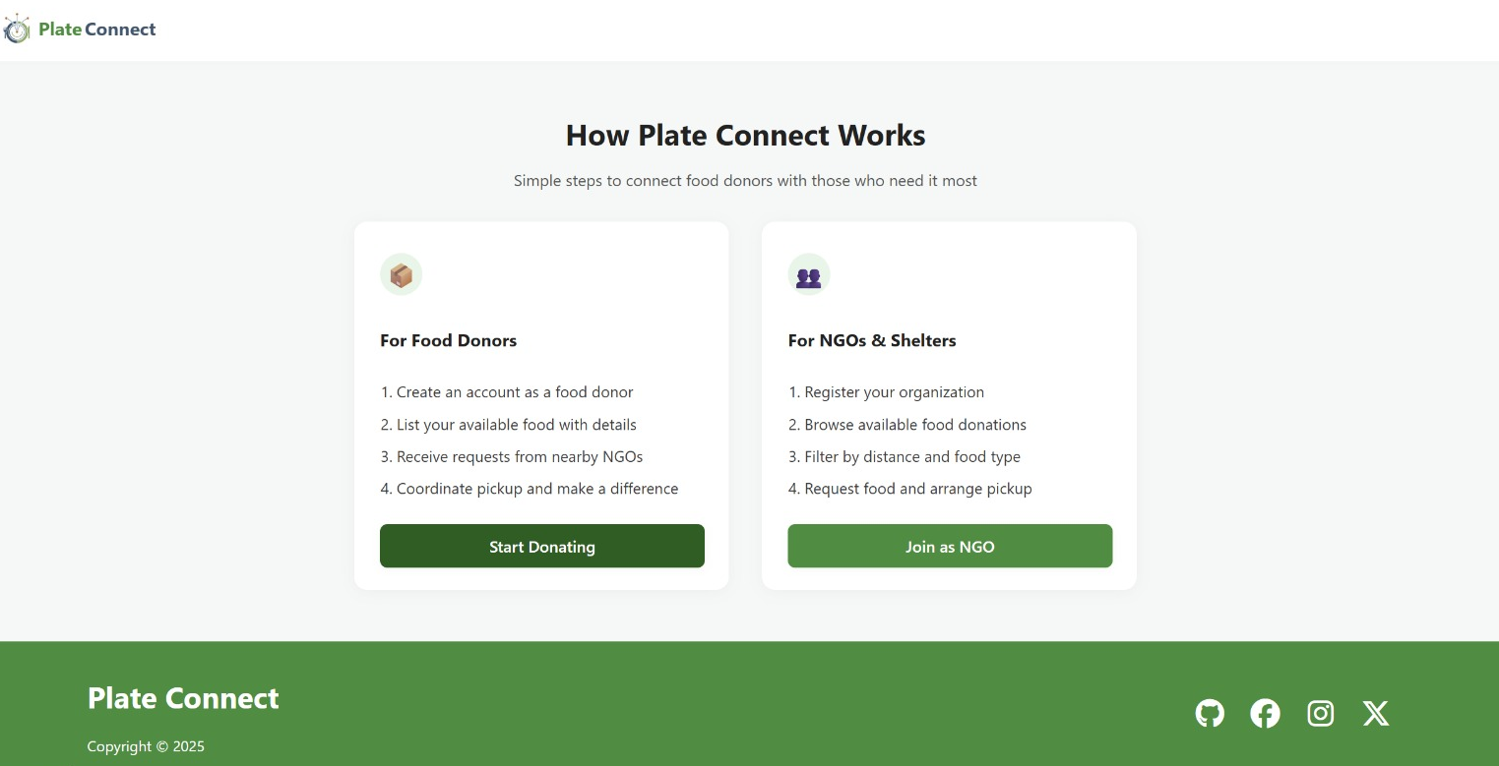
SCREENSHOTS
Overview of the Website

Slide 13
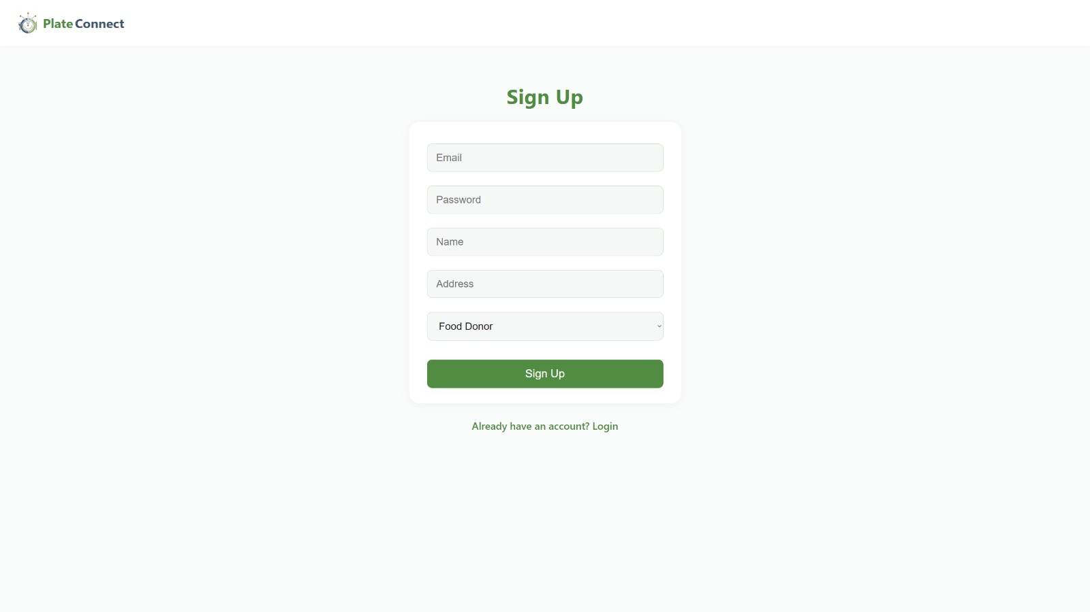
SCREENSHOTS
Sign Up Page

Slide 14
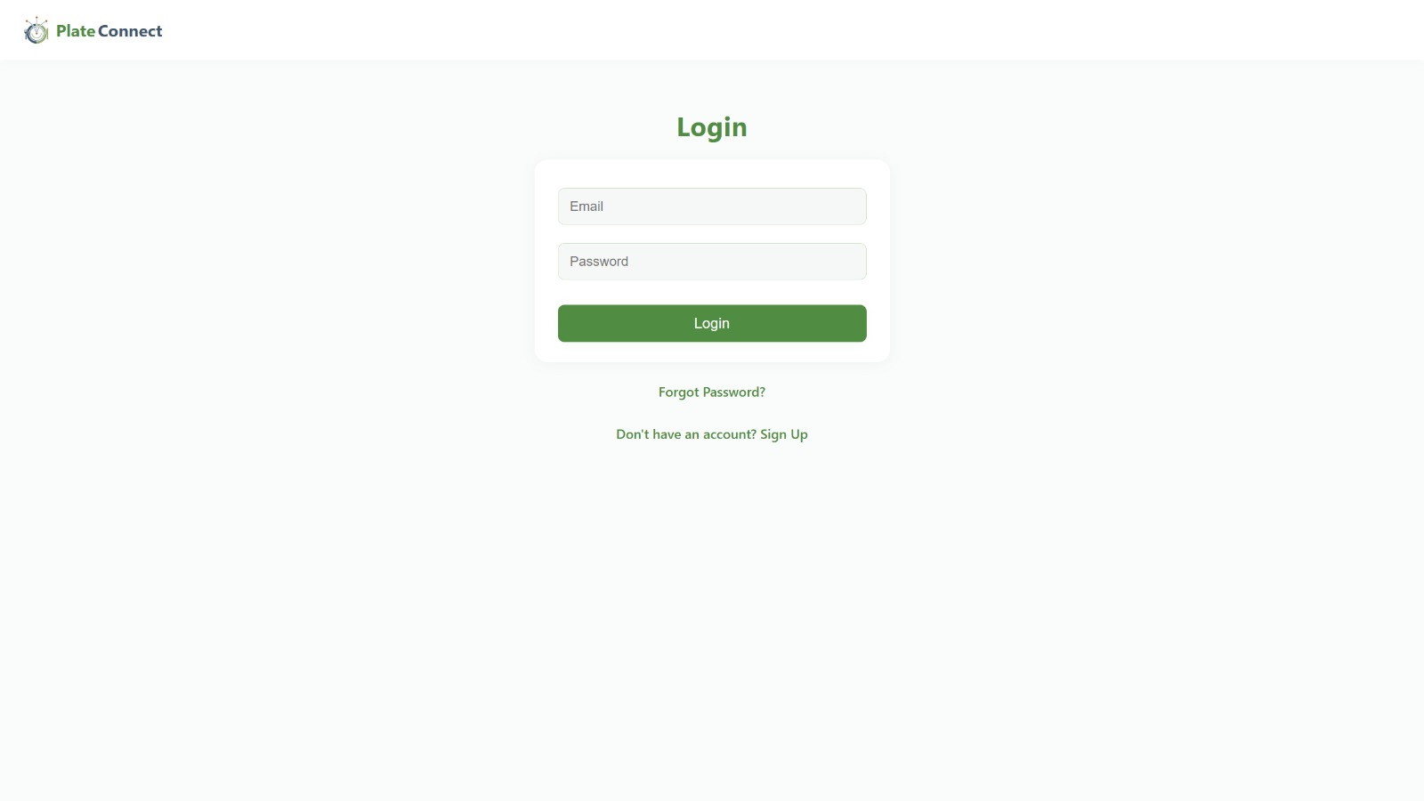
SCREENSHOTS
Login Page

Slide 15
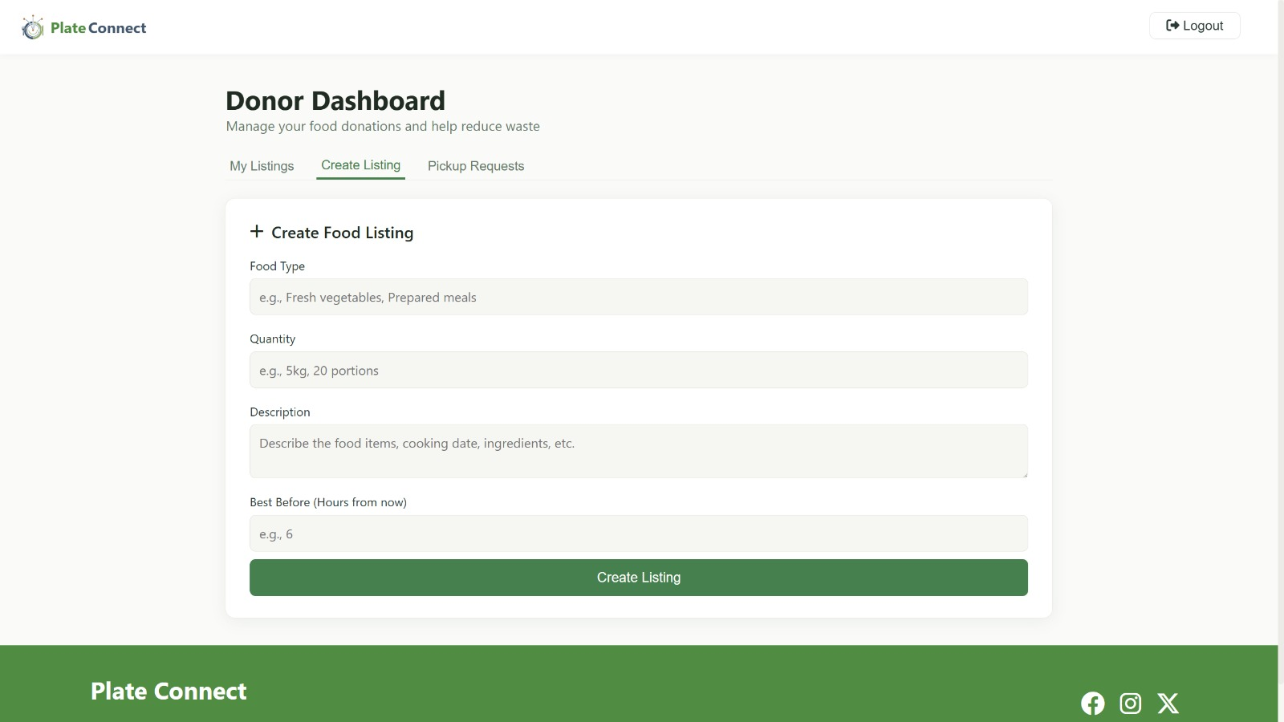
RESULTS
Donor Dashboard

Slide 16
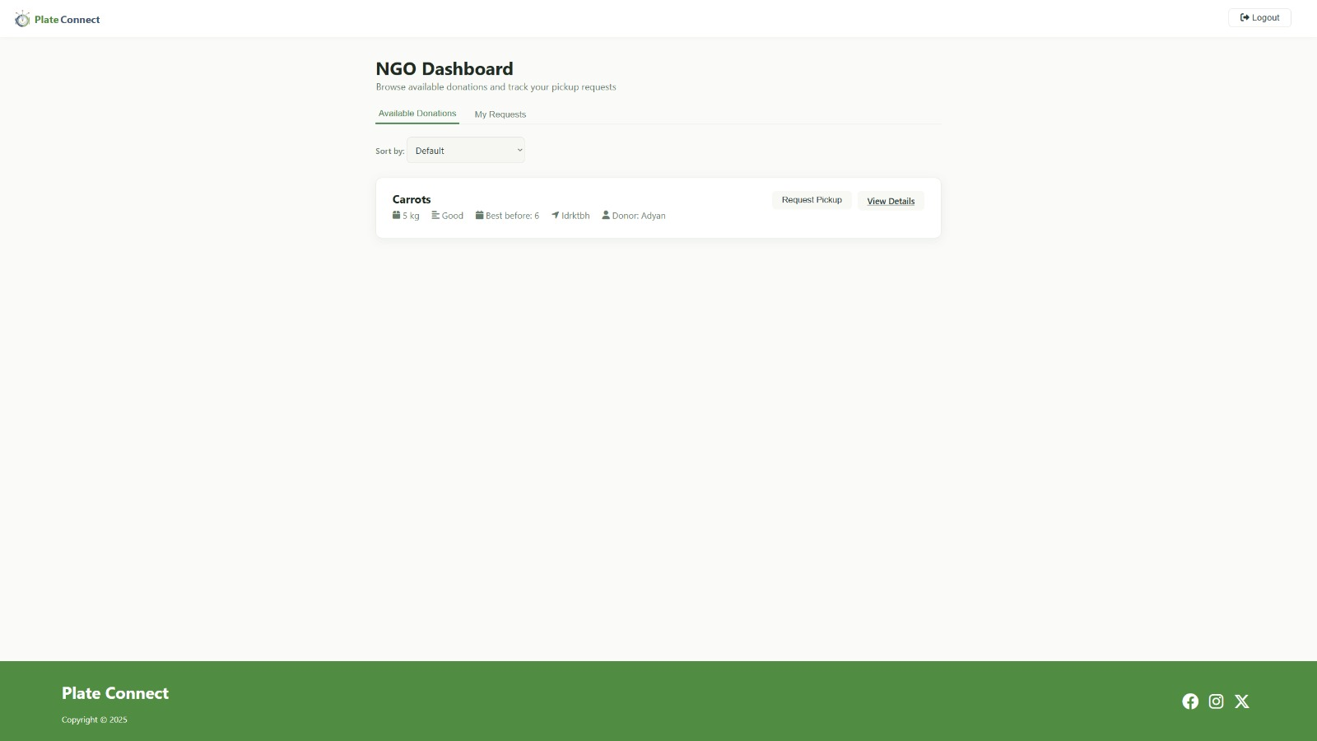
RESULTS
Donor Food Entry

Slide 17
FUTURE WORK
Develop a mobile application for easier access and real-time notifications.
Implement AI-based prediction to forecast food demand and donation trends.
Add real-time delivery tracking and automated pickup scheduling.
Integrate multi-language support to increase accessibility.
Collaborate with government agencies and NGOs for wider community impact.

Slide 18
CONCLUSION
The Food Donation and Redistribution Platform effectively connects food donors with receivers, reducing food waste and supporting community welfare.
By using smart matching, location-based services, and an easy-to-use interface, it ensures efficient and ethical food distribution.
The project promotes sustainability, social responsibility, and contributes to solving food insecurity in society.
It demonstrates how technology can be leveraged to create a positive social and environmental impact.

Slide 19
REFERENCES
Books / Research papers :-
1) Esparza, Elizabeth. "Best Practices in Technology-Based Solutions for Food Redistribution.“
2) Vijay, K., Thilak Kumar, D. Srinidhi, and S. Ujjain. "Serve Surplus: A Smart Food Redistribution Platform for Reducing Urban Food Waste and Combating Hunger." In 2025 3rd International Conference on Sustainable Computing and Data Communication Systems (ICSCDS), pp. 1734-1738. IEEE, 2025
3) Murthy, Ramana, R. Rajesh Sharma, Anmol Kaul, C. S. Nithya, and S. Himabindu. "Digital Stage for Surplus Food Redistribution: Undertaking Food Waste Through Online Donations." In 2024 International Conference on Signal Processing and Advance Research in Computing (SPARC), vol. 1, pp. 1-5. IEEE, 2024.
4) Chakraborty, Sudeshna, Anshumaan Sharma, Shivam Raj, and Nirupma Singh. "A Smart Waste Food Management and Donation Platform Leveraging Machine Learning and Web Technologies." In International Conference On Innovative Computing And Communication, pp. 549-564. Singapore: Springer Nature Singapore, 2025.

Slide 20
ACKNOWLEDGEMENT
I am profoundly grateful to Prof. Manila Gupta for her expert guidance and continuous encouragement. I would like to express deepest appreciation towards Dr. Varsha Shah, Principal RCOE, Mumbai and Prof. Mohd. Juned ,HOD Department of Computer Engineering RCOE for their invaluable guidance. Finally, I must express my sincere heartfelt gratitude to all the staff members of the Computer Engineering Department.

Slide 21
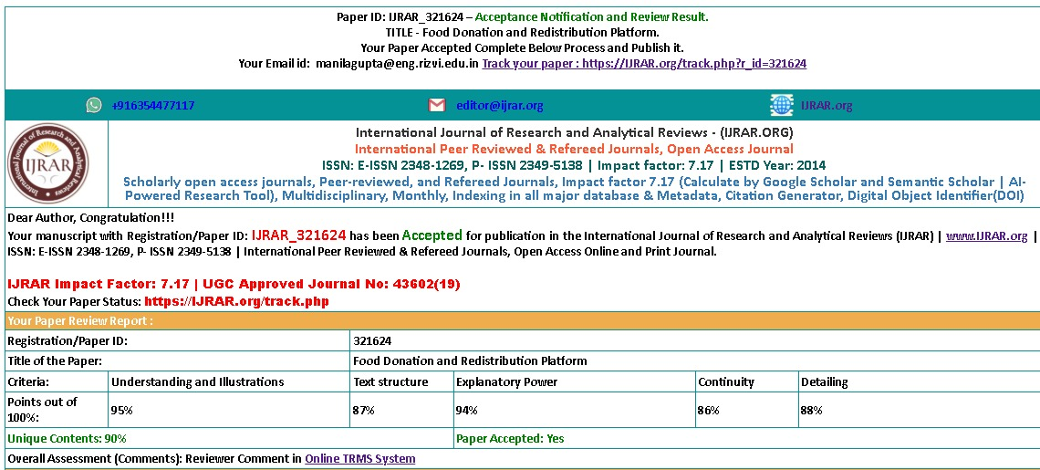
PAPER PUBLICATION
Publications:-
We are pleased to announce that our research paper has been accepted for publication in the International Journal of Research and Analytical Reviews (IJRAR), a UGC-approved, peer-reviewed journal.
This acceptance reflects the quality and relevance of our work in the field of digital signage systems.

